Slide 1

Use of site monitoring data for Continuous Quality Improvement (CQI) in Jamaica
Giselle Guevara
Laboratory Advisor, CDC Caribbean Office
RTCQI Best practices workshop
August 2024
(contributions by Janet Neil, GLESSN)

Slide 2
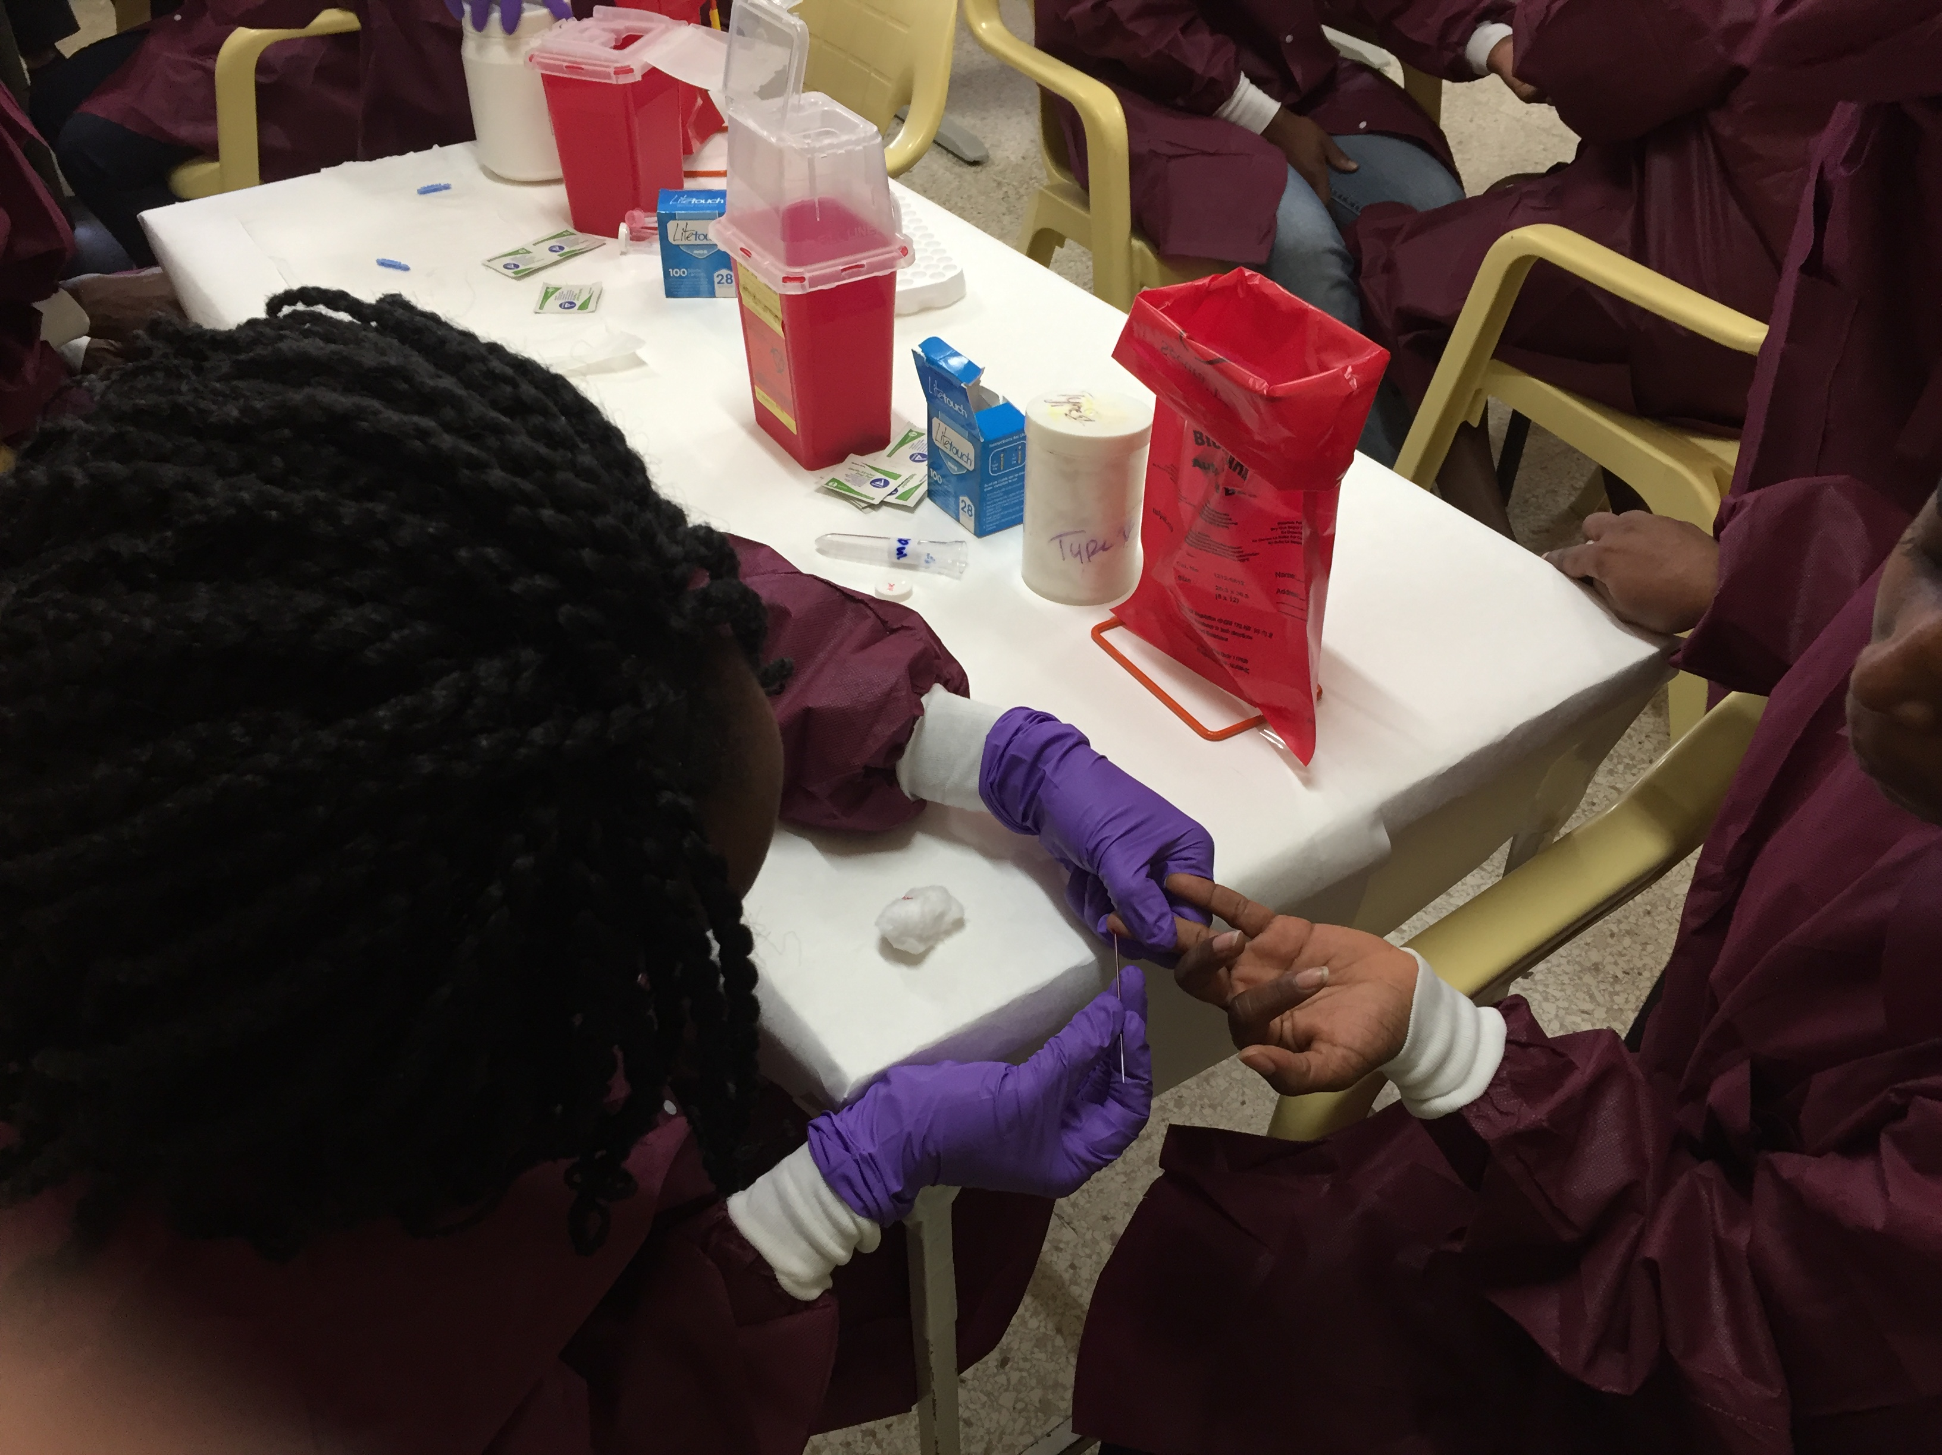
Program review – 2023
Jamaica started RTCQI program in 2015.
Looking at the data and implementation activities from 2015 – 2023, we conducted a review of the program.
  How have the sites performed since their baseline assessments?
  What types of quality management systems or programs have been implemented because of the RTCQI program?
  What were/are the challenges in implementing the
  RTCQI program?
  4. What areas of the program have been least effective?
Review questions
1
2
3
4

Slide 3
Program review -2023 (cont’d)
Based on the consolidated data, site feedback, HR complement and
patient needs, several RTCQI program improvements were implemented. These included:
Objective
Objective
Objective
  Executed a stepwise approach for implementing QMS at the sites
Updated the workplan frequency for site assessments
Developed criteria for adding new sites
Future Impact - Ensure additional RT testing (i.e. syphilis) are implemented with CQI

Slide 4
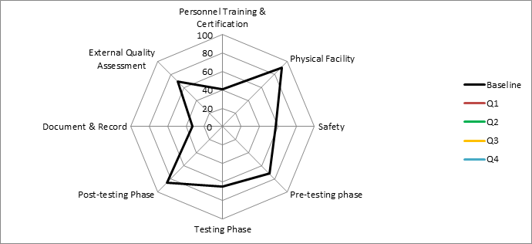
Baseline audits 2015 – Insights & Improvement Opportunities
RED – opportunities for Improvement
Notes:
Issues identified included -
The provision of testing and safety supplies by Ministry of Health is sometimes delayed. This has resulted in inconsistent use and documentation of required supplies by testing staff.
There was a general lack of knowledge in inventory management, waste segregation, corrective action and documentation. These areas were addressed by the Q-Corp through training at the sites and the provision of standard operating procedures.
House-keeping and janitorial services also needed to be trained on laboratory waste management.
Training deficiencies and the absence of training records was observed at some sites. A standardized HIV Rapid Testing training and certification program was not available in Jamaica and this has led to different levels of knowledge of the HIV rapid testers. The training ranged from two weeks to three months and there was a general lack of records and details of training.

Slide 5
Addressing Training gaps – 2015 - 2023
Date of training | Training Topics
May 2015 | RTCQI Module training and DTS production
May 2018 | RTCQI Module training and DTS expansion
November 2020 | Standardized Logbook, Proficiency Testing (PT), Safety and Waste Management
February 2021 | Root Cause Analysis and Corrective Actions
March 2021 | Ethics and Logbook use
August 2021 | Refreshers - Quality Control (QC) and Logbook review
March 2022 | Refreshers - Corrective Actions and Logbook analysis
September 2022 | Refreshers - Use of the HIV/Syphilis Logbook
March 2023 | HIV and Syphilis Rapid test Training of Trainers (TOT)
April & May 2023 | ePT – implementation and Use
July 2024 | Safety in the Laboratory

Slide 6
Objective 1: Criteria for adding new sites
Benefits
The overall goal is to improve the quality of service at HIV testing sites (HTS).
In Jamaica, the programme has subsequently expanded from 12 to 26 sites over the last seven years. It has become entrenched as one of the best initiatives used for continuous improvement at HTS.
As these sites show consistency by remaining at Level 4 for 1 year, they can be graduated; new sites will replace them, increasing the number of sites included in the improvement initiative.
High testing volume and High burden sites (serves high catchment area)
HTS and HIV treatment services integrated into the site
01
02
04
03
Non-governmental organization sites (PEPFAR-supported)*
Serves some key populations
Ease of access to potential clients
In 2023 there were 12 sites eligible for graduation.
New sites are added when a formal request is made to CDC office by the Ministry of Health or, via its Regional Managers.

Slide 7
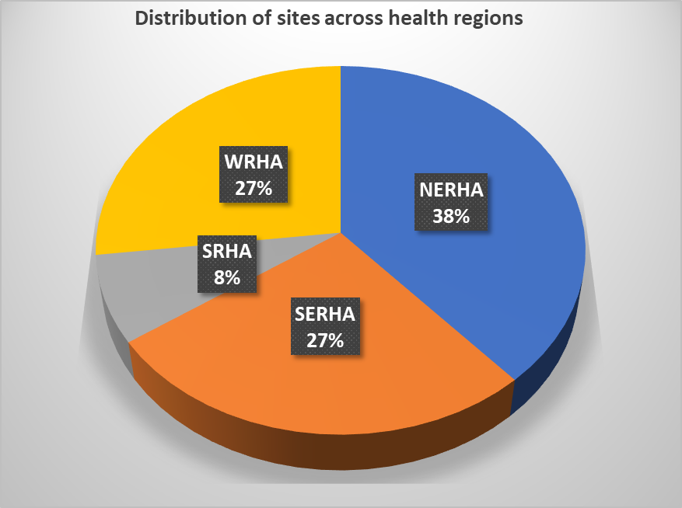
Annual increase in sites by Region
2015 - 2022
100% increase in sites
Highest burden region

Slide 8
Objective 2: Frequency of assessments
The assessor must ensure however, that there have been no major changes in personnel, or other adverse event, that could have affected the rating of the site. Any major change would warrant an assessment.
Sites retaining level 4 scoring for 8 consecutive assessments will be assessed annually
Sites obtaining ≥91% for 3 consecutive assessments, will be assessed twice annually.
Sites receiving less than 91% should be assessed quarterly
New sites are assessed quarterly until they obtain the criteria outlined in 1

Slide 9
RTCQI sites by program areas + assessment frequency
As of 2023, the 26 sites enrolled are distributed across 4 health regions & 3 program areas. The four VCT/HTC sites are also classified as treatment sites and all are non-governmental organizations (mainly serving KP).
Notes:
There are presently 26 high burden, high- volume or sites that serve key populations or high priority groups enrolled in the RTCQII program.
The sites were assessed mostly on a quarterly basis. However, there had been times when only two or three assessments per year were completed for some countries.
Moving forward (2024) sites in Jamaica which retained their level 4 scoring for 8 consecutive assessments will be assessed annually.

Slide 10

Objective 3: Stepwise approach to implementing QMS at the sites
Engaged the National Quality Coordinator, Regional Medical Technologists and Parish Supervisors,
to implement the basic QMS documents across the sites.
Documents to be included are:
Quality Manual (ISO 15189)
Safety Manual (ISO 15190)
Infection Prevention and Control (SIMS requirements)
Document control SOP
Sample reception SOP with rejection criteria
Job Aides for Fingerstick, Kit use and Waste disposal, handwashing, Post exposure prophylaxis
01
Document Control
Document control numbers have been obtained for each Region from the Quality Assurance Coordinator, National Reference laboratory
03
Program documents
Record management
02
Procedures relating to modules of the MOHW HIV programme, already at all the sites, will be document controlled
04
The controlled documents are organized in labelled folders or on computers, where available.
www.free-powerpoint-templates-design.com

Slide 11
Overall site performance - April 2021 to June 2023
Notes:
Between April 2021 and September 2022 there were six assessments and the sites more or less maintained their percentage levels. No site scored below level 3;
The best performance or results for the sites were at the February 2022 assessment where 81% achieved level 4 and 19% level 3.
At the final assessment in December 2022, the percentage of sites that scored level 4 decreased slightly from 81% to 78%, 11% scored level 3 and 11% level 2. The level 2 scoring was again due to a sites at borderline level 3 achieving a slightly less score than in its previous assessments. ( Note, Level 2 sites were from the new sites added in 2022.)
So far in 2023, the four new sites that were added, received their baseline assessments. The results were split evenly across levels 3 and 4 with 50% each.
Current status – 25/26 sites have been assessed resulting in 14 at Level 4, 11 at Level 3 and one at Level 2.

Slide 12
Impact of RTCQI on HIV testing & quality assurance
1. Implementation of the ePT to manage events, eliminated time spent manually marking results. Results returned through the ePT as soon as Managers release them.
5. Implementation of the ODK Dashboard helps to collate, analyze and disseminate the completed checklist to stakeholders for faster reporting.
2. HIV logbook data has helped the MOH to better determine the number of kits used annually and to inform procurement of kit quantities (stock outs ↓75%).
6. Enrollment of additional sites has resulted in greater quality in the HIV testing services, and lower testing error rates (>3%).
7. Improvement in coverage, uptake & impact of the QA cycle, as sites with non-conformities implemented activities to address them and improved their operation
3. Implementation and wide scale adoption of the standardized logbook in all HTS sites and now Syphilis RT
4. Over 500 persons (HIV testers, Quality staff, Nurses, etc.) have benefited from training related to the quality assurance cycle and HIV testing.
8. Documented data available for algorithm review, positivity trend analysis and monitoring kit quality.
Notes:
Standardized HIV logbook/ register - has assisted greatly in keeping proper records on test numbers, positive samples, invalid samples and informing procurement activities and also, anomalies in testing.
Emphasis has been placed on site visits and monitoring, because it allows the supervisors and the Testers to develop a better relationship. Some sites in Jamaica have developed and implemented tools that detailed the activities conducted during visits.
There was improvement in the coverage, uptake and impact of the QA cycle because sites cited for non-conformities implemented activities to address those non-conformities and improved their QA.

Slide 13
Lessons Learnt in Jamaica
HIV 1/2
Focus on HR and Personnel capacity issues first
Strong HR results in strong program implementation.
Facility size doesn’t negate good document/record keeping (SOPs, Manuals).
Agree on harmonized Documentation (Quality system) structure
WHAT
WHY
Communicate audit results early and often, continue supervisory visits
PDCA - Sites lacking supervisory visits don’t perform as well.
Share common documentation, i.e. SOPs, Job Aides, manuals, etc. & work together on common Gaps.
Don’t reinvent the wheel. Customize and harmonize

Slide 14
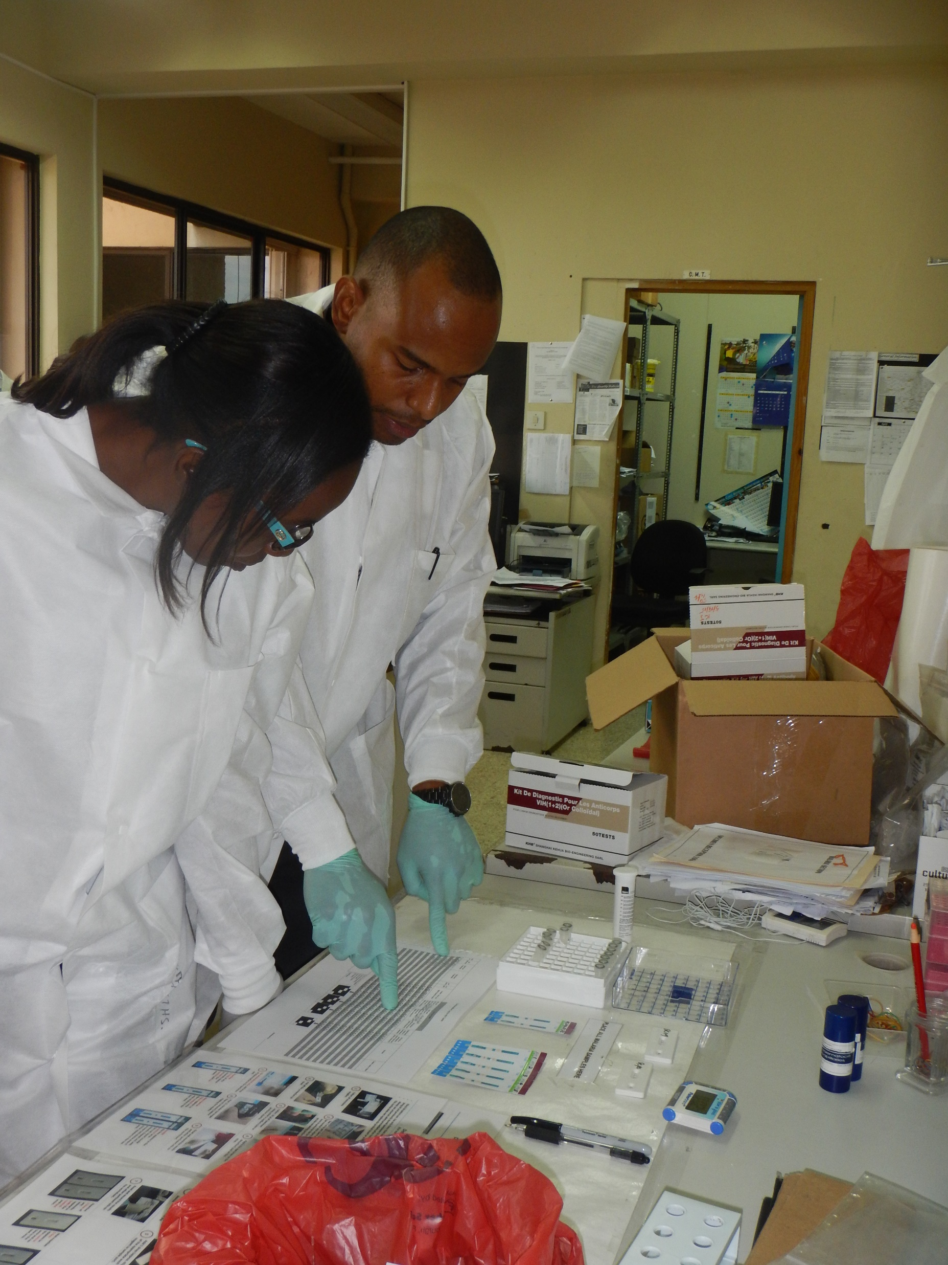
Lessons Learnt in Jamaica
Answers to review questions -
  How have the sites performed since their baseline assessments?
      YES (over 75% sites achieve and maintain Level 4)
  2) What types of quality management systems or programs have been implemented because of the RTCQI program?
      Quality and Safety systems, SOPs and Job aides sufficient to meet CQI needs following ISO 15189 Reqts
  3) What were/are the challenges in implementing the RTCQI program?
      Harmonization of documents; frequent staff turnover; informal Certification program
  4) What areas of the program have been least effective?
      Post market surveillance, Syphilis DTS, HIV Testing policy finalization
1
?
2
?
3
?
4
?
Notes:
Sites receiving regular supervisory visits do far better than those lacking these visits.
Certain areas need additional guidance such as Inventory management, training documentation, and reporting of supervisory visits.

Slide 15
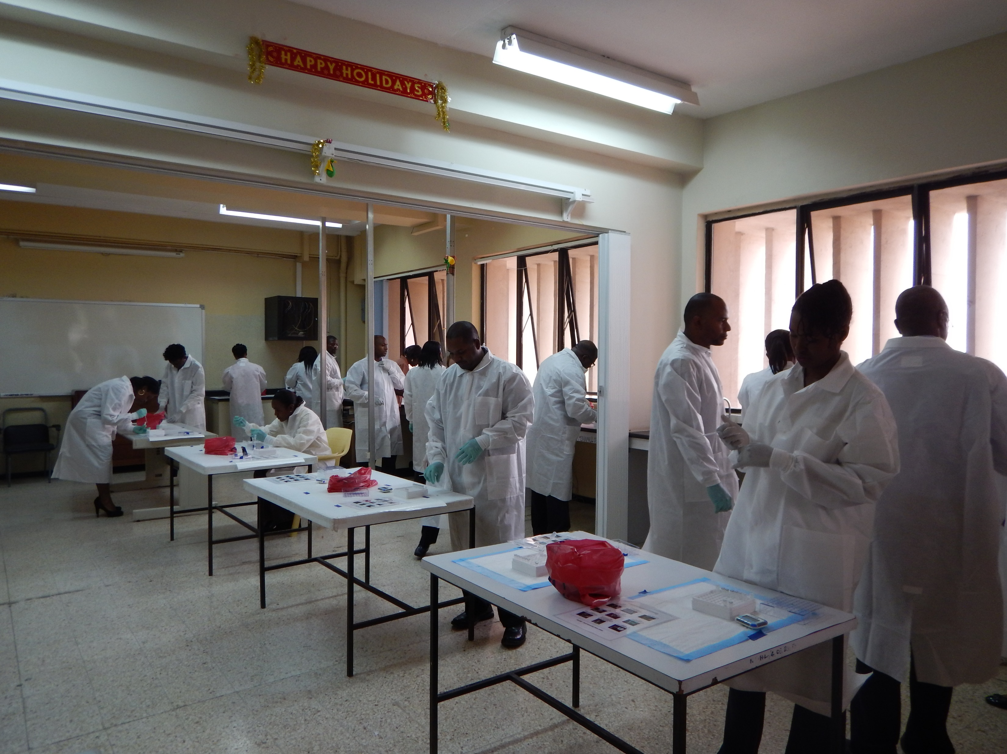
THANK YOU

